Slide 1

ICBD – ABA Centre Finance
By
27th February 2026
Sigmasoft - ICBD Confidential

Slide 2







Project Scope
Data Visualization
Income Statement
Balance Sheet
Data Integration
Visualization Features
Review and apply minor enhancements to the existing Power BI Income Statement dashboard.
Add bottom‑section analytics currently maintained in Excel (unit counts, per‑unit values, subtotals, averages).
Integrate statistical accounts from NetSuite for operational metrics.
Implement monthly trending visualizations & additional calculated metrics based on the provided Excel template.
Maintain all existing
filters:
Subsidiary
Location
Department
Time period (monthly)
Build a new Balance Sheet dashboard following NetSuite’s financial structure.
Implement a monthly trending view instead of a single point‑in‑time snapshot.
Enable drill‑down capabilities consistent with the Income Statement.
Apply filters:
Subsidiary
Location
Time period
Align the layout and visual theme with the Income Statement dashboard.
Items related to connecting, sourcing, and integrating data.
Direct Power BI connection to NetSuite
Use of NetSuite statistical accounts
Ensuring a single, consistent data source for all metrics
Automated refresh scheduling
Items relating specifically to functional interaction and analytics capabilities.
Drillable financial statement hierarchy
Contribution analysis (subsidiary / location)
Contextual visuals (Revenue, Net Income, Expenses)
Standardized, clean, aligned visual layout
Filters & Dimensions
Documentation & Knowledge Transfer
Cash Flow
Items defining data slicing, filtering, and user-selectable views.
Subsidiary filter
Location filter
Department filter (Income Statement only)
Time period selection (monthly granularity)
Items related to handover, training, and long-term maintenance.
Dashboard user guide
Technical documentation
Knowledge transfer session with ABA team
Build a new Cash Flow dashboard using NetSuite’s cash flow report structure.
Implement monthly trending visualizations.
Enable drill‑down interactions aligned with the other two financial dashboards.
Apply filters:
Subsidiary
Location
Time period
Ensure a consistent layout and design across all financial dashboards.
Sigmasoft - ICBD Confidential

Slide 3
Project Scope
Sigmasoft - ICBD Confidential

Slide 4
Project Milestone
Week 3
Week 4
Week 5
Data & Model Setup
NetSuite Validation, Semantic Model, and Transformation.
Income Statement Development
KPI Definition, Prototype, Dashboard development and initial Validation
Data & Model Setup
Data Model Enhancement if required.
Balance Sheet Development
KPI Definition, Prototype, Dashboard development and initial Validation
Data & Model Setup
Data Model Enhancement if required.
Cash Flow Development
KPI Definition, Prototype, Dashboard development and initial Validation
Sigmasoft - ICBD Confidential

Slide 5

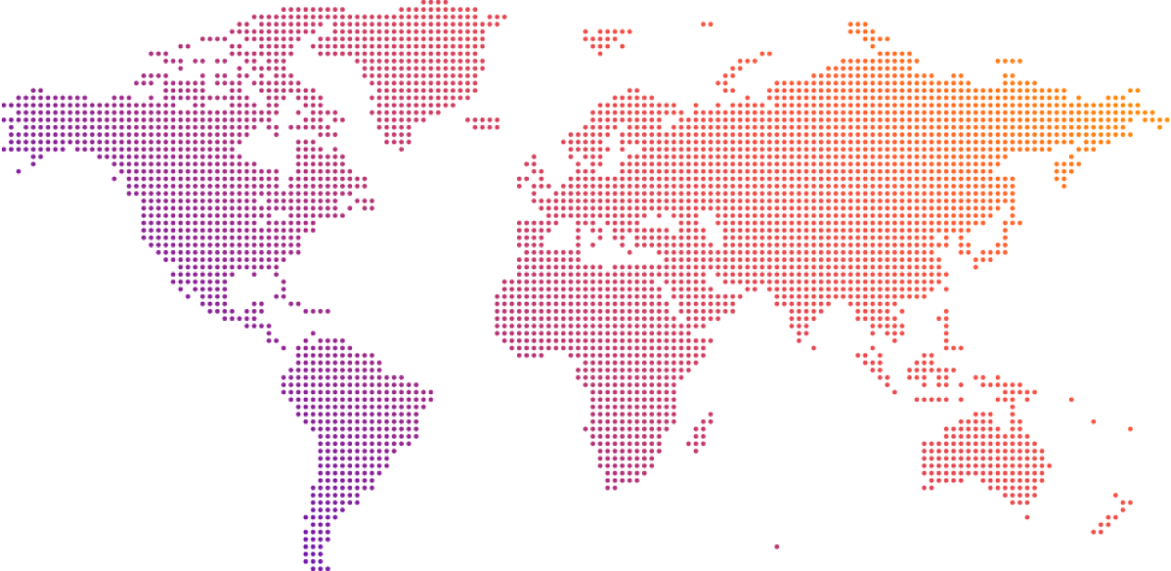

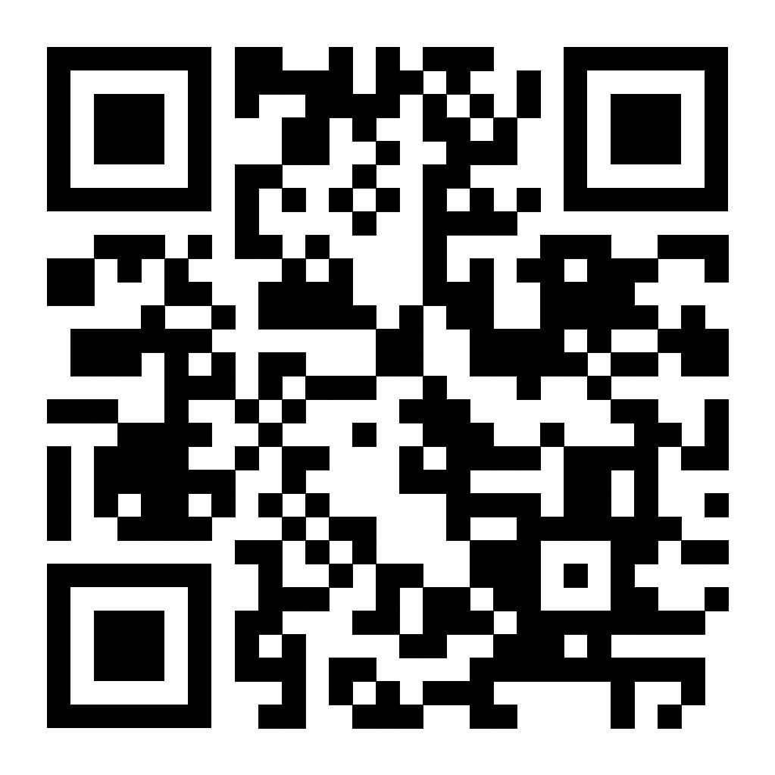
A cloud first, AI ready global IT services, consulting and business solutions leader
Santa Clara
Halifax
Hyderabad
Bangalore
Dallas
https://www.sigmasoft.ai
Thank you !
Our team of experts enables business growth through innovation, integration, and technology: using right-fit strategy and best-in-class people to build lasting relationships with our clients.
Our Vision :
To be a leading global consulting and information - technology company integrated with key industry partners, cared for by its employees, and trusted by its Clients.
Our Mission :
We create strategies, designs, deployments, and enhancements to deliver world-class customer, partner and employee experiences.
We do this to empower our client's employees, customers and partners to work the way they want on their devices of choice.
We are "THE" leading experience partner.
Sigmasoft - ICBD Confidential

